Slide 1
THE LIFE OF CHRIST
PART 54

Slide 2
John 9:1 Now as Jesus passed by, He saw a man who was blind from birth. ² And His disciples asked Him, saying, "Rabbi, who sinned, this man or his parents, that he was born blind?"

Slide 3
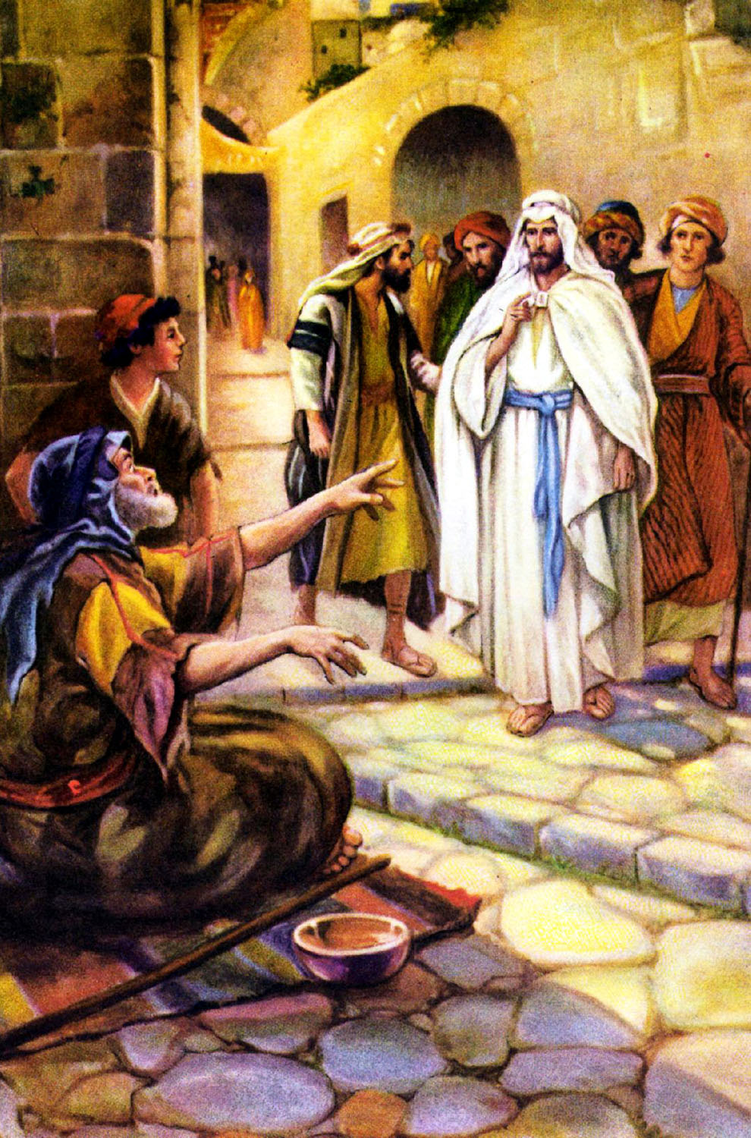

Slide 4
John 9:3 Jesus answered, "Neither this man nor his parents sinned, but that the works of God should be revealed in him. ⁴ "I must work the works of Him who sent Me while it is day; the night is coming when no one can work. ⁵ "As long as I am in the world, I am the light of the world."

Slide 5
It was prophesied that He would be this shining light (Isa. 9:2; Mt. 4:14-16; Lk. 1:79). Jesus called Himself this light on many occasions (Jn. 3:19; 8:12; 9:5; 12:46; Rev. 22:16). His light exposes the darkness of sin, and it reveals the truth. Even when Jesus was physically taken out of the world, He did not leave us in darkness because He left us His Word, which reveals that same light (2 Tim. 1:10; 2 Pet. 1:19; Ps. 119:105).

Slide 6
Psalm 27:1 The LORD is my light and my salvation; Whom shall I fear? The LORD is the strength of my life; Of whom shall I be afraid?

Slide 7
Not only does Jesus continue to be the light for us through His Word, He will be the eternal light of heaven (Rev. 21:23). So, if we want to be pleasing to God, we must believe on the light and become sons of light (Jn. 12:36), walk in the light (1 Jn. 1:6, 7), put on the whole armor of light (Rom. 13:12), and shine as a reflection of that light (Isa. 60:1; Phil. 2:15; Acts 13:47).

Slide 8
John 9:6 When He had said these things, He spat on the ground and made clay with the saliva; and He anointed the eyes of the blind man with the clay. ⁷ And He said to him, "Go, wash in the pool of Siloam" (which is translated, Sent). So he went and washed, and came back seeing.

Slide 9
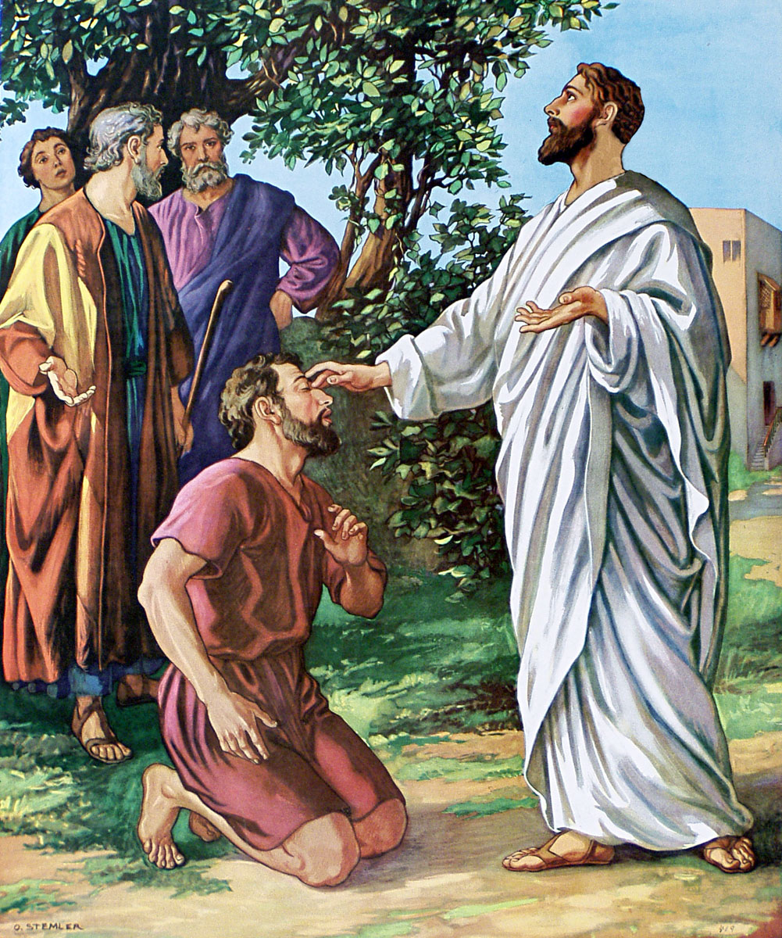

Slide 10
Its name was derived from the fact that its waters were “sent” into the pool by a channel:
South of the temple mount is a basin hewn out of the rock in part and partly built of masonry, fifty-three feet long, eighteen feet wide and nineteen feet deep, which is identified as Siloam. A stream, rising in the fount of Siloam, passes through the reservoir, which is used for domestic purposes.

Slide 11
This pool is located in the southeast part of the city where the Tyropoean Valley joins the Kidron. Its waters come from the Gihon Spring by way of the tunnel built by Hezekiah (2 Kings20:20; 2 Chron. 32:30).At the Feast of Tabernacles the waters of Siloam were used to symbolize the blessings of God upon the people, and Jesus had related the symbolism to Himself (John 7:37-38). John wants his readers to see that the blessings which the man was to experience really came from Messiah, the Sent One. In Isaiah 8:6 these same waters were used to describe God’s provision for His people (Power Lectureship, The Sayings of Jesus p. 424).

Slide 12
John 9:8 Therefore the neighbors and those who previously had seen that he was blind said, "Is not this he who sat and begged?" ⁹ Some said, "This is he." Others said, "He is like him." He said, "I am he." ¹⁰ Therefore they said to him, "How were your eyes opened?" ¹¹ He answered and said, "A Man called Jesus made clay and anointed my eyes and said to me, 'Go to the pool of Siloam and wash.' So I went and washed, and I received sight." ¹² Then they said to him, "Where is He?" He said, "I do not know."

Slide 13
John 9:13 They brought him who formally was blind to the Pharisees. ¹⁴ Now it was a Sabbath when Jesus made the clay and opened his eyes. ¹⁵ Then the Pharisees also asked him again how he had received his sight. He said to them, "He put clay on my eyes, and I washed, and I see." ¹⁶ Therefore some of the Pharisees said, "This Man is not from God, because He does not keep the Sabbath." Others said, "How can a man who is a sinner do such signs?" And there was a division among them. ¹⁷ They said to the blind man again, "What do you say about Him because He opened your eyes?" He said, "He is a prophet."

Slide 14
John 9:18 But the Jews did not believe concerning him, that he had been blind and received his sight, until they called the parents of him who had received his sight. ¹⁹ And they asked them, saying, "Is this your son, who you say was born blind? How then does he now see?" ²⁰ His parents answered them and said, "We know that this is our son, and that he was born blind; ²¹ "but by what means he now sees we do not know, or who opened his eyes we do not know. He is of age; ask him. He will speak for himself." ²² His parents said these things because they feared the Jews, for the Jews had agreed already that if anyone confessed that He was Christ, he would be put out of the synagogue. ²³ Therefore his parents said, "He is of age; ask him."

Slide 15
John 9:24 So they again called the man who was blind, and said to him, "Give God the glory! We know that this Man is a sinner." ²⁵ He answered and said, "Whether He is a sinner or not I do not know. One thing I know: that though I was blind, now I see."

Slide 16
John 9:26 Then they said to him again, "What did He do to you? How did He open your eyes?" ²⁷ He answered them, "I told you already, and you did not listen. Why do you want to hear it again? Do you also want to become His disciples?"

Slide 17
John 9:28 Then they reviled him and said, "You are His disciple, but we are Moses' disciples. ²⁹ "We know that God spoke to Moses; as for this fellow, we do not know where He is from."

Slide 18
John 9:30 The man answered and said to them, "Why, this is a marvelous thing, that you do not know where He is from; yet He has opened my eyes! ³¹ "Now we know that God does not hear sinners; but if anyone is a worshiper of God and does His will, He hears him. ³² "Since the world began it has been unheard of that anyone opened the eyes of one who was born blind. ³³ "If this Man were not from God, He could do nothing." ³⁴ They answered and said to him, "You were completely born in sins, and are you teaching us?" And they cast him out.

Slide 19
Even though this man was not inspired by God, he claimed that God does not hear sinners, which is true, and it is supported by several Old Testament Scriptures (Ps. 34:15-16; Prov. 1:28-31, 15:29, 28:9; Mic. 3:4; Zech. 7:12-13).

Slide 20
“If anyone is a worshiper of God and does His will, He hears him (Jn. 9:31).” There are many passages that imply this truth as well (Prov. 8:17; Acts 10:4; Jas. 4:8).

Slide 21
John 9:35 Jesus heard that they had cast him out; and when He had found him, He said to him, "Do you believe in the Son of God?" ³⁶ He answered and said, "Who is He, Lord, that I may believe in Him?" ³⁷ And Jesus said to him, "You have both seen Him and it is He who is talking with you." ³⁸ Then he said, "Lord, I believe!" And he worshiped Him.

Slide 22
John 9:39 And Jesus said, "For judgment I have come into this world, that those who do not see may see, and that those who see may be made blind." ⁴⁰ Then some of the Pharisees who were with Him heard these words, and said to Him, "Are we blind also?" ⁴¹ Jesus said to them, "If you were blind, you would have no sin; but now you say, 'We see.' Therefore your sin remains.

Slide 23
John 3:17 "For God did not send His Son into the world to condemn the world, but that the world through Him might be saved. ¹⁸ "He who believes in Him is not condemned; but he who does not believe is condemned already, because he has not believed in the name of the only begotten Son of God.

Slide 24
Mt. 13:14-15; Isa. 6:9-10

Slide 25
“If you were blind, you would have no sin; but now you say, 'We see.' Therefore your sin remains.”

